Slide 1

By: Edwin Ho, Roldan Gammad, Peter Truong, Efren Aguilar, and Alex Deuling

Slide 2
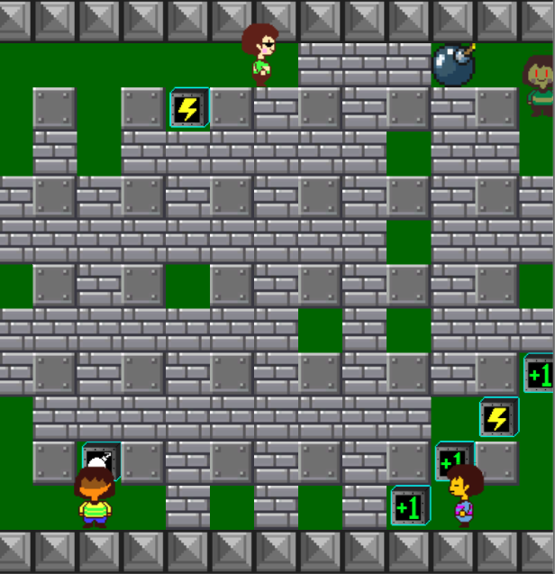
Core Gameplay
4 Player Local Multiplayer
Different controls on players.
Preparing for networking milestones.
Win/Lose Condition
Drop bombs to sabotage other players.
Last person standing.
Four power ups
Speed Up (Lightning Bolt)
Bomb Count (White Bomb)
Explosion Size (Green +1)
Invulnerability (Blue Shield)

Slide 3
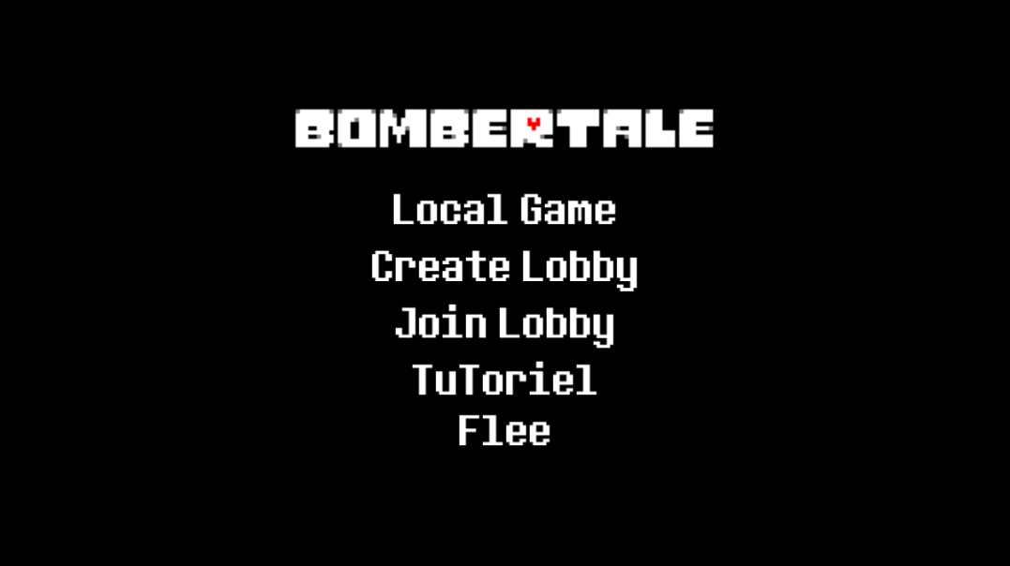
Some Extras
UI:
Main Menu
End Menu
Sounds
Animations

